Slide 1
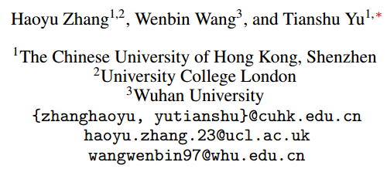
ATAI
Advanced Techniqueof Artificial Intelligence
ATAI
ChongqingUniversity _{AdvancedTechniqueof}
of Technology Artificial Intelligence
Chongqing University of Technology
Chongqing University ^{ATAI}
_{of Technology} Advanced Techniqueof
Artificial Intelligence
Chongqing University of Technology
Chongqing University of Technology
LNLN:Towards Robust Multimodal Sentiment Analysis with Incomplete Data
Code: https://github.com/Haoyu-ha/LNLN
2024.11.7•ChongQing
——NeurIPS 2024
Reported by Lele Ren
1

Slide 2
ATAI
AdvancedTechniqueof
Artificial Intelligence
ATAI
ChongqingUniversity _{AdvancedTechniqueof}
of Technology Artificial Intelligence
ChongqingUniversity of Technology
Motivation
In practical applications of Multimodal Sentiment Analysis (MSA), incomplete data is a common issue, leading to modality loss or noise interference, which poses challenges for sentiment analysis. Although some methods have proposed solutions to address data incompleteness, these methods lack consistency in test evaluations, making effective comparison and generalization difficult. This paper proposes an MSA model that can maintain robustness and high accuracy even in environments with missing data and noise.

Slide 3
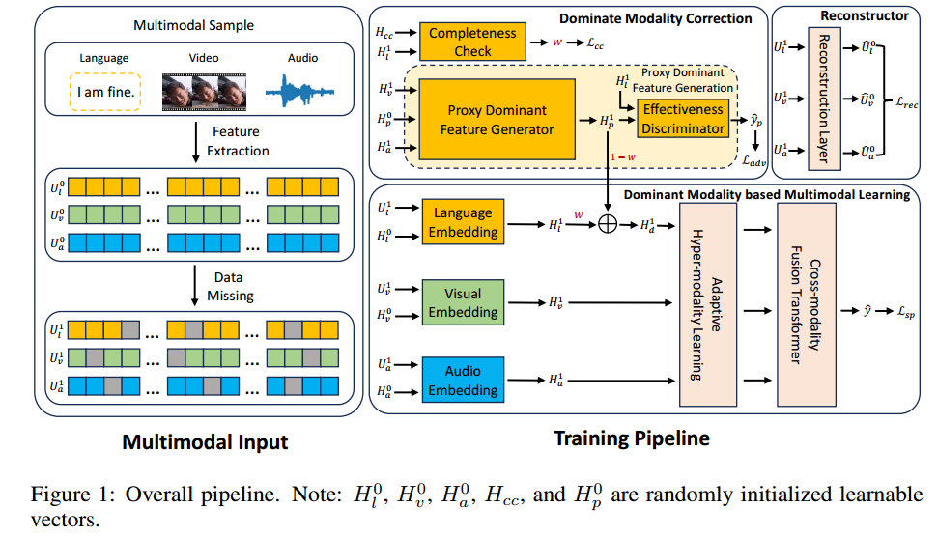
ChongqingUniversity of Technology
ATAI
AdvancedTechniqueof
Artificial Intelligence
ATAI
ChongqingUniversity _{AdvancedTechniqueof}
of Technology Artificial Intelligence
Overview

Slide 4
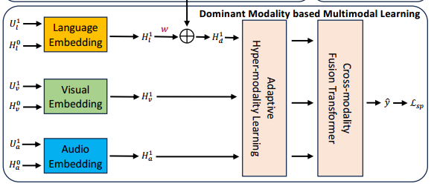
ChongqingUniversity of Technology
ATAI
AdvancedTechniqueof
Artificial Intelligence
ATAI
ChongqingUniversity _{AdvancedTechniqueof}
of Technology Artificial Intelligence
Method

Slide 5
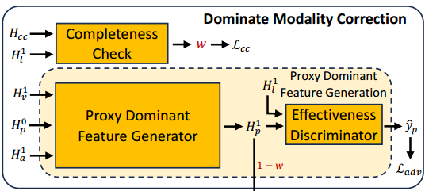
ChongqingUniversity of Technology
ATAI
AdvancedTechniqueof
Artificial Intelligence
ATAI
ChongqingUniversity _{AdvancedTechniqueof}
of Technology Artificial Intelligence
Method

Slide 6
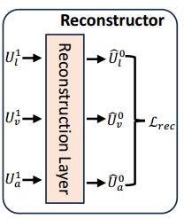
ChongqingUniversity of Technology
ATAI
AdvancedTechniqueof
Artificial Intelligence
ATAI
ChongqingUniversity _{AdvancedTechniqueof}
of Technology Artificial Intelligence
Method

Slide 7
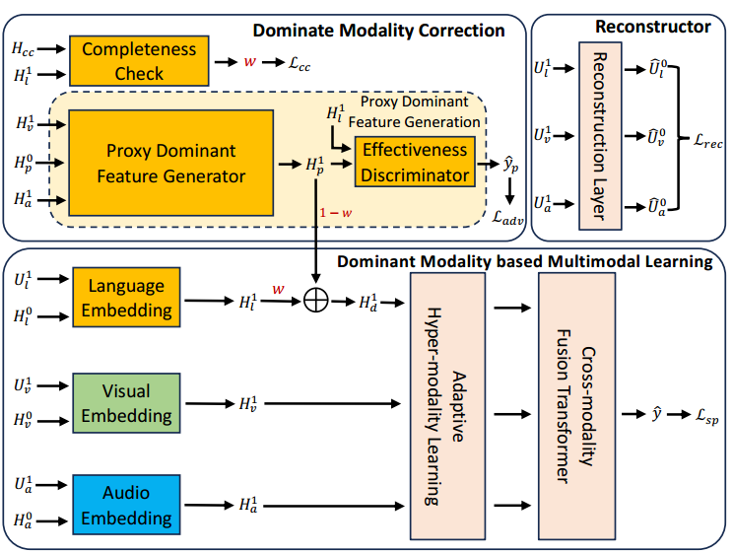
ChongqingUniversity of Technology
ATAI
AdvancedTechniqueof
Artificial Intelligence
ATAI
ChongqingUniversity _{AdvancedTechniqueof}
of Technology Artificial Intelligence
Method

Slide 8
ATAI
AdvancedTechniqueof
Artificial Intelligence
ATAI
ChongqingUniversity _{AdvancedTechniqueof}
of Technology Artificial Intelligence
ChongqingUniversity of Technology
Experiments

Slide 9
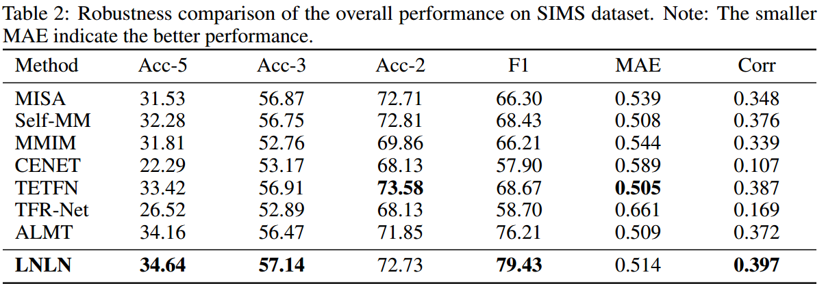
ATAI
AdvancedTechniqueof
Artificial Intelligence
ATAI
ChongqingUniversity _{AdvancedTechniqueof}
of Technology Artificial Intelligence
ChongqingUniversity of Technology
Experiments

Slide 10
ATAI
AdvancedTechniqueof
Artificial Intelligence
ATAI
ChongqingUniversity _{AdvancedTechniqueof}
of Technology Artificial Intelligence
ChongqingUniversity of Technology
Experiments

Slide 11
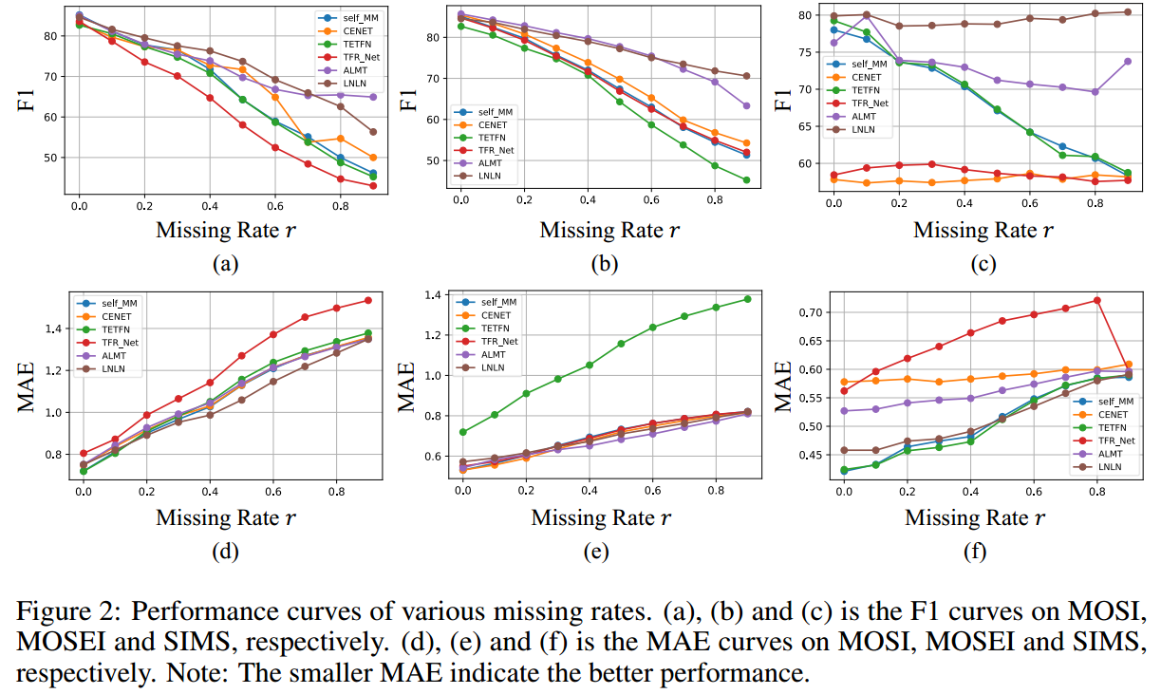
ATAI
AdvancedTechniqueof
Artificial Intelligence
ATAI
ChongqingUniversity _{AdvancedTechniqueof}
of Technology Artificial Intelligence
ChongqingUniversity of Technology
Experiments

Slide 12
ATAI
AdvancedTechniqueof
Artificial Intelligence
ATAI
ChongqingUniversity _{AdvancedTechniqueof}
of Technology Artificial Intelligence
ChongqingUniversity of Technology
Experiments

Slide 13
ChongqingUniversity of Technology
ATAI
AdvancedTechniqueof
Artificial Intelligence
ATAI
ChongqingUniversity _{AdvancedTechniqueof}
of Technology Artificial Intelligence
Thanks!

